Slide 1
Comp 433 Ecommerce Service
Dariusz Jedralski
Luna Celestine

Slide 2
Service Concept
Proposed as service to manage customers, orders, products, and partners. Built to be able to function as a marketplace
Things to do:
Add, retrieve, update, remove products
Add, retrieve, update, remove customers, add payments
Add, retrieve, update, remove partners, allow management of partner products
Add, retrieve, update, remove orders

Slide 3
Client Concept
Administrative interface to help a worker place orders for customers over the phone
Tasks to accomplish include
Place orders for customers
Update Customer Information (addresses, Payments, ect.)
Manage Partners
Manage Products

Slide 4
Exposed Endpoints
orderservice
order – get
/order/{orderId} – get
/order –post
/order/{orderId} –put – (update products, clients, status, ect)
/order/{orderId} – delete
customerservice
customer – get
/customer/{customer} – get
/customer –post
/customer/{customer} –put (update payments)
/customer/{customer} - delete

Slide 5
Exposed Endpoints (cont.)
Productservice
Product – get
/product/{productId} – get
/product –post
/product/{productId} –put (update prices)
/product/{productId} – delete
partnerservice
partner – get
/partner/{partnerId} – get
/partner –post
/partner/{partnerId} –put
/partner/{partnerId} - delete

Slide 6
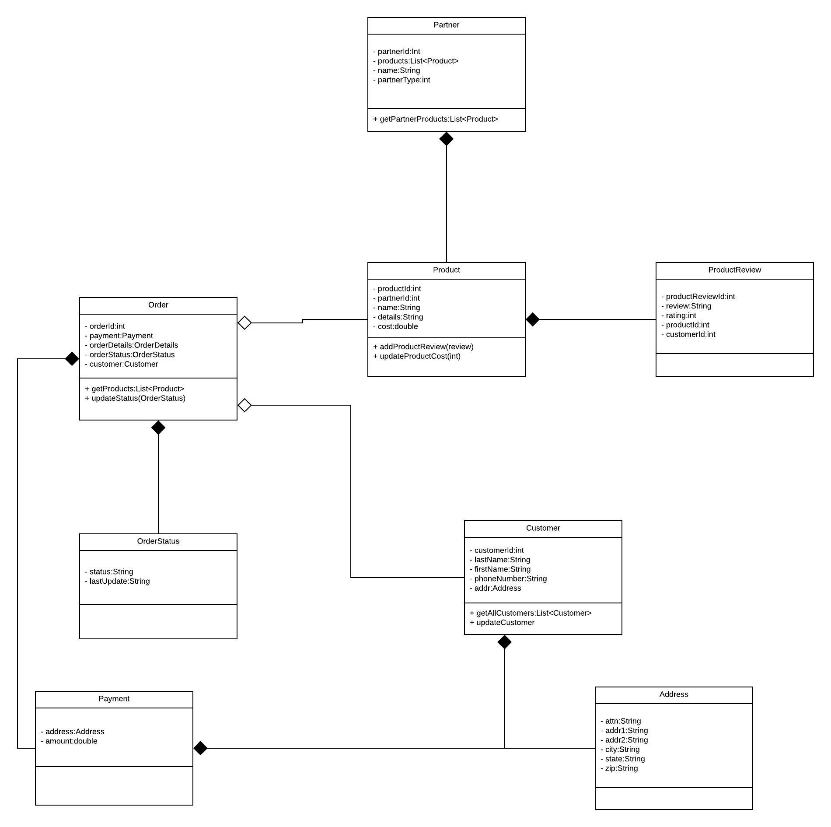
UML

Slide 7
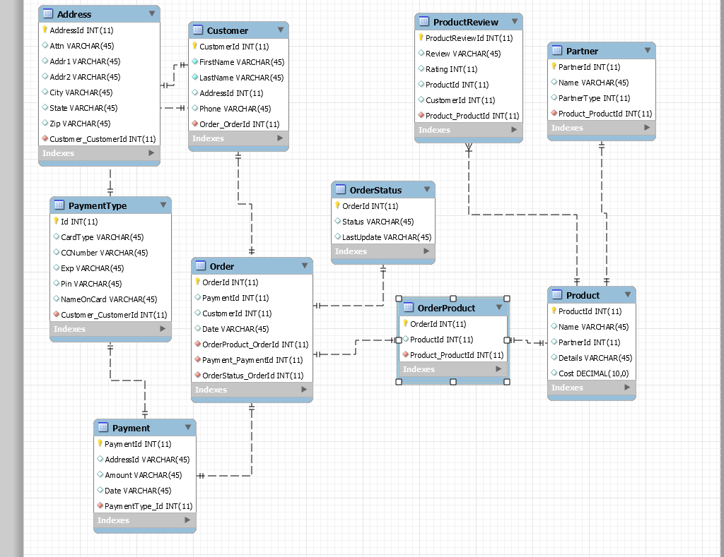
Database

Slide 8
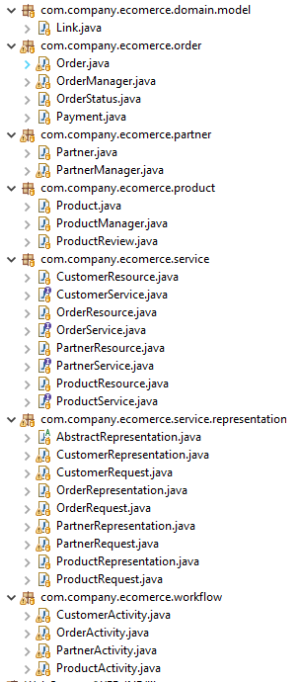
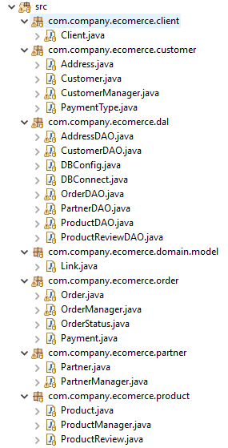
Architecture

Slide 9
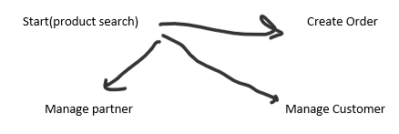
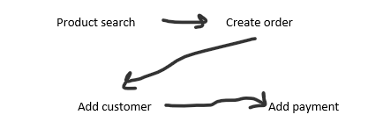
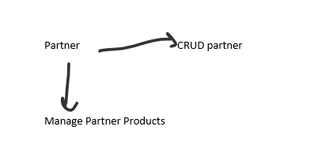
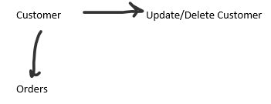
Client Workflow

Slide 10
Demo

Slide 11
Roadblocks/ Issues
Java – both of us were fairly inexperienced
Eclipse – settings did not transfer well
AWS – New to AWS and cloud management
Time – Scheduling

Slide 12
Future Considerations
Fix null reference issues in service
Improve Error handling.
Fix basic auth with client.
Expand the functionality (add reviews to products)

Slide 13
Questions?

